Slide 1


Emails and Letters:
Audience, Purpose, and Occasion
Additional slides to address common questions from audience
Notes:
This file discusses the style and form associated with writing emails and letters in scientific writing. More discussion can be found in the first section of Lesson 9 of The Craft of Scientific Writing, 4th ed. (which will be abbreviated CSW throughout this handout): CSW, pp. 154-165.

Slide 2
To begin writing, you need
content
Notes:
An essential ingredient of any technical document is content. Certainly you need not have every detail set in stone before you begin writing, but you should have the overall “story” of the document before you commit time to writing the document.

Slide 3
In an email announcement, the content consists of the who or what, the when, the where, and often the why
who or what:
College of Engineering Speaking Contest
when:
September 5, 2018
7:00-8:30 p.m.
where:
112 Kern Building
why:
????
Notes:
Example of content for a simple email that makes an announcement. The decision to address the why would depend on the audience, purpose, and occasion.

Slide 4
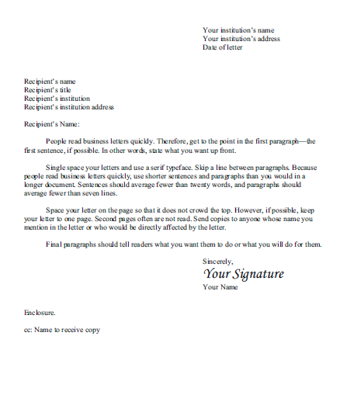
Once you know your content, you should analyze the constraints
who are they?
why are they reading?
what do they know?
how will they read?
audience
pu rpose
occasion
Notes:
CSW: pp. 154-156 (also, pp. 3-5).

Slide 5
Once you have defined your audience,
consider what they know and do not know
…I have taken E Mch 211
and E Mch 212.
…I have taken E Mch 211
and E Mch 212.
…I have taken courses in
statics and dynamics.
Notes:
This particular weak example I have seen students write in many ways. Here, the student has written a sentence in a job application email or letter without considering the audience. Few employers around the world would recognize E Mch 211 and E Mch 212 are. For that to happen, the employer would have had to attend that particular institution recently. I show this example as an excerpt from an actual job application email and ask the students for their comments. Usually they identify right away the incorrect targeting of audience. Then I animate in the takeaway and the revision. CSW: pp. 154-156 (also, pp. 3-5).

Slide 6
Weak correspondence is often marked by the author
not considering why the audience is reading
I am interested in obtaining a research position in a gas turbine lab. I am finishing my bachelor of science in mechanical engineering this May.
I have also had summer internships at General Electric Aviation and at Boeing.
I am interested in obtaining a research position in a gas turbine lab. I am finishing my bachelor of science in mechanical engineering this May.
I have also had summer internships at General Electric Aviation and at Boeing.
Notes:
CSW: p. 161.

Slide 7
In well-written correspondence, the author
balances the I with the you
Your laboratory interests me because this summer, I am working for one of your research sponsors: Pratt & Whitney. In particular, your experiments concerning the effects of sand on turbine components described on your website particularly appeals to me because through family members in the military, I have learned about the negative effects that sand can have on aircraft engines.
Your laboratory interests me because this summer, I am working for one of your research sponsors: Pratt & Whitney. In particular, your experiments concerning the effects of sand on turbine components described on your website particularly appeals to me because through family members in the military, I have learned about the negative effects that sand can have on aircraft engines.
Your laboratory interests me because this summer, I am working for one of your research sponsors: Pratt & Whitney. In particular, your experiments concerning the effects of sand on turbine components described on your website particularly appeals to me because through family members in the military, I have learned about the negative effects that sand can have on aircraft engines.
Notes:
CSW: p. 161.

Slide 8
Understanding how your audience reads
affects how you name file attachments
Attachment: Howell_Beth_resume.pdf
Attachment: resume.pdf
Attachment: resume.pdf
Notes:
This particular weak example I see in with most attachments. The author names the file for himself or herself, but not for the audience that will receive the file, place it into a folder, and try to retrieve it later. To be retrieved, such a file needs to have the author’s name on it. On my own personal laptop, I have more than 100 files named resume.pdf that came from students seeking employment or a recommendation. Many comments in CSW about titles (page 158, for example) apply to names of files.

Slide 9
Before writing the correspondence,
you should analyze the constraints
As with all scientific writing, the purpose of correspondence is to inform and to persuade
who are they?
why are they reading?
what do they know?
how will they read?
audience
purpose
occasion
to inform
to persuade
Notes:
CSW: pp. 156-157 (also, pp. 5-8).

Slide 10
While all scientific correspondence informs, different types of correspondence have different levels of persuasion
persuading
and informing
informing
Notes:
CSW: pp. 156-157 (also, pp. 5-8).

Slide 11
Exercise: Rank the following correspondence situations
from least persuasive to most persuasive
Announcement of a Meeting
Application for a Job
Petition for a Change of a Grade
Thank You
persuading
and informing
informing
Notes:
Have the students pair up and discuss the exercise on the slide above. You might tell them that no single level of persuasion exists for each type of email. However, they should be able to rank the ranges of persuasion. CSW: pp. 156-157 (also, pp. 5-8).

Slide 12
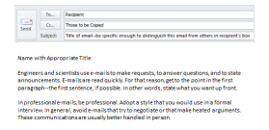

While all scientific correspondence informs, different types of correspondence have different levels of persuasion
Application
for position
Announcement
persuading
and informing
informing
Thank you
Petition
for change
Notes:
Ask the students what they came up with in the exercise. Although they might not come up with the exact order depicted here, they should have the announcement and thank you to the left and the job application email and petition for grade change to the right. Remind them that no single level of persuasion exists for each type of email. However, they should be able to rank the ranges of persuasion. Be sure to preview this slide in the slideshow model before projecting so that you know what comes next. CSW: pp. 156-157 (also, pp. 5-8).

Slide 13
Also important to consider with emails and letters
Is the occasion: the format and mechanics
You should begin the writing process
by analyzing your constraints
who are they?
why are they reading?
what do they know?
how will they read?
audience
purpose
occasion
to inform
to persuade
format
mechanics
Notes:
I usually ask the students to recall what we mean by the words “format” (layout and typography) and “mechanics” (grammar, punctuation, usage, and spelling. The text book defines all these words. CSW: pp. 157-158 (also, pp. 8-11).

Slide 14
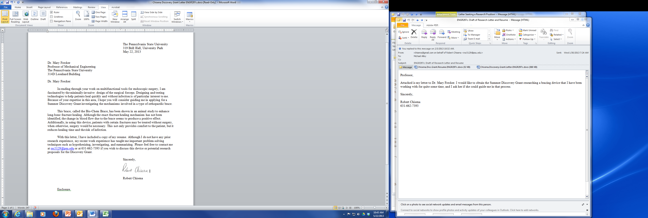
Format is the layout and typography
of a document
Choice of typeface
Positioning
of type
Size of type
Line spacing
and indents
Notes:
On this slide, ask the students what is meant by typography and layout. As a simple definition, typography includes the choice of type and the size of type. In scientific writing, those choices have to be professional. Layout, on the other hand, is the positioning of typeface on the page. Shown in the example letter is a common letter format in professional writing—many artists refer to this one as semi-block (as opposed to another common format called block, which has all the text blocks begin on the left margin). CSW: Appendix D.

Slide 15
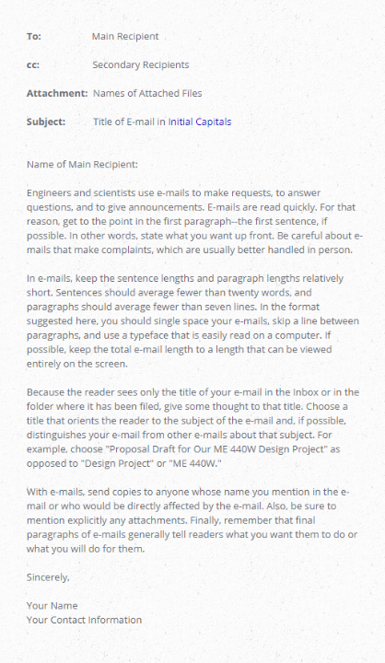
The writing website shows
a format for emails
www.craftofscientificwriting.com
Notes:
The website “Writing Guidelines for Engineering and Science” contains a professional format for emails that students can download: http://www.craftofscientificwriting.com/email_format.html

Slide 16
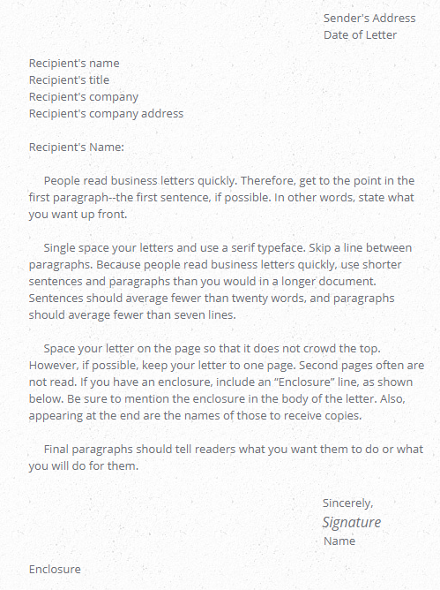
The site also provides
a format for letters
www.craftofscientificwriting.com
Notes:
The website “Writing Guidelines for Engineering and Science” contains a professional format for emails that students can download: http://www.craftofscientificwriting.com/letter_format.html

Slide 17
Emails and Letters:
Audience, Purpose, and Occasion
Additional slides to address common questions from audience
Notes:
This file has analyzed audience, purpose, and occasion in the writing emails and letters in scientific writing. More discussion can be found in the first section of Lesson 9 of The Craft of Scientific Writing, 4th ed. Related files contain perspectives of structure and language in writing emails and letters.

