Slide 1
Title of Presentation in Initial Capitals:
36 Points, Calibri Bold
Replace this box with key image to introduce talk’s scope, importance, or background
Replace with
your Logo
Notes:
This file presents an assertion-evidence template for making effective slides for scientific presentations. Although much about the layout and typography contrasts sharply with the defaults of PowerPoint, these changes are done so to make the slides more effective at communicating technical information. The design advocated by this template arises from Chapter 4 of The Craft of Scientific Presentations, 2nd edition (Springer, 2013). The homepage for this template exists at the following website:
http://assertion-evidence.com
Right now you are viewing the general template. Currently, you will not be allowed to modify from this document. To work on the slides, click on “Make a Copy” under “File.” Doing this action will allow you to recreate this document on your own drive, enabling full editing. Note: You must be signed into your google account to make a copy. Warning: You are more than welcome to use this template for your presentation slides. You may not, though, distribute this template for profit or distribute this template without giving credit to the source: http://writing.engr.psu.edu/
This slide is for the title slide of a presentation. See pages 172-184 in The Craft of Scientific Presentations, 2nd ed. (CSP).

Slide 2
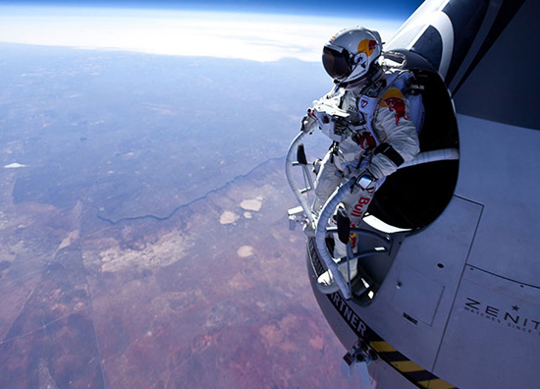
Taking Engineering to New Heights
Lauren Murphy
Sarah Krishner
Engineering Ambassadors
The Pennsylvania State University
2
Notes:
The beginning of a presentation is important for making the audience excited about and have the audience feel comfortable with the topic. If you are using a slide to open a presentation, include an image or series of images that provides a good entry point to the talk. An effective image helps orient the audience to the key words in the title. An effective image, such as what Lauren Murphy and Sarah Krishner included, also gives you the opportunity to say a few things about your work—perhaps addressing the work’s importance or providing key background information. Forcing yourself to spend more time with this slide is good because a common mistake in presentations is not to leave the title slide on long enough. Because of this mistake, many in the audience do not have the chance to comprehend the key details of the title.
Reference:
Murphy, Lauren & Sarah Krishner (2011). Taking Engineering to New Heights. University Park: Penn State Engineering Ambassadors.

Slide 3
This presentation focuses on… (complete sentence, but go no more than two lines)
Image for
Topic 1
Topic 1
Image for
Topic 2
Topic 2
Image for
Topic 3
Topic 3
Notes:
Mapping slide for the presentation (note that a background slide or a slide justifying the importance might precede this slide). A common mistake with mapping slides is to give the audience simply an unmemorable bulleted list of topics (including the names “Introduction” and “Conclusion” and “Questions”). Such a list is quickly forgotten after the slide is removed.
On a mapping slide, take the opportunity to show a key image or perhaps a representative image for each major section of the presentation. In the second case, each image would be repeated on the first visual of the corresponding section and would remind the audience that they have arrived to a major section of the presentation’s middle.
In regards to the names “Introduction” and “Conclusion,” every talk has those sections, and the names are ignored by audiences. So why state them? Also, for the divisions that you do have, find a logical and parallel grouping. Note that groups of two’s, three’s, and four’s are much easier to remember and are not so nearly intimidating as groups of five’s, six’s, and seven’s. See the discussion of mapping slides in The Craft of Scientific Presentations, 2nd ed. (pages 177-181).

Slide 4
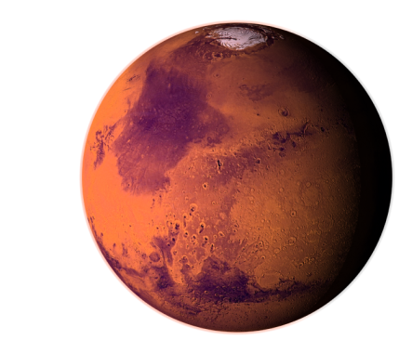
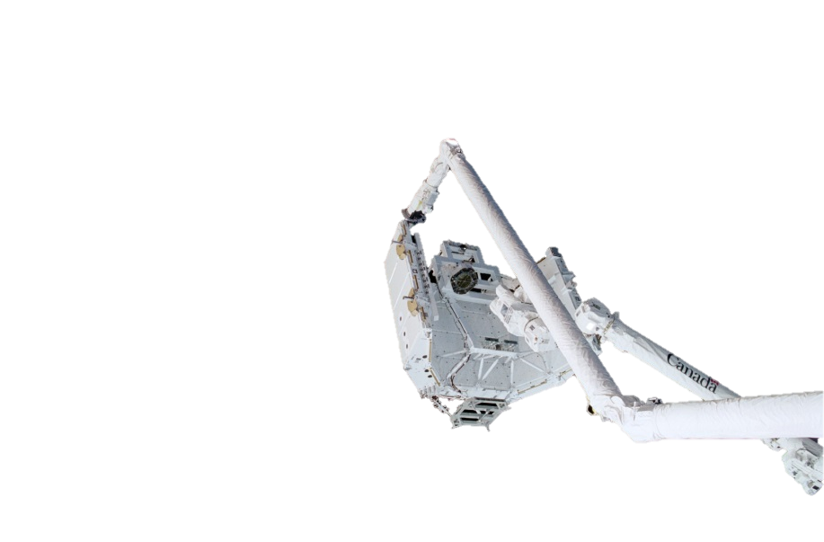
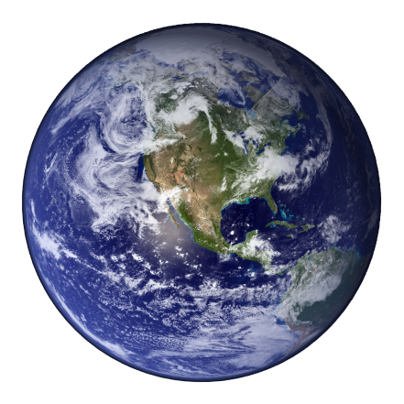
We will explore different types of engineering
and how they apply to manned space travel
Traveling in Space
Leaving Earth
Other Space Challenges
Notes:
Sample mapping slide.
Reference:
Stevens, Dana, and Luke Kuprenas (2016). Nuclear Powered Spaceflight. Troy NY: Rensselaer Polytechnic Institute, Engineering Ambassadors.

Slide 5
Notes:
Blank slide for drafting mapping slide

Slide 6
This sentence headline makes an assertion on the first topic in no more than two lines
Image(s)
supporting above assertion
If necessary, identify key assumption or background for audience—keep to two lines (18–24 point type)
Notes:
Body slide from the first section of the presentation’s middle. Consider having the first-topic image from the mapping slide repeated here. Use the headline (no more than two lines) to make an assertion about this topic. In the body of the slide, support that headline with images and with words, if necessary. See Chapter 4 of The Craft of Scientific Presentations, 2nd ed.
This slide shows one orientation for the image and text in the body of the slide. Other orientations appear in this template. Choose the one that best supports your headline assertion.
Some institutions will insist that you place an institutional logo on each slide. Other institutions recommend a logo on the first slide and the last. If you do place a logo on each slide, make sure that logo is at the bottom of the slide rather than the top. Placing the logo at the top (the place on a slide that receives the most emphasis) shifts the emphasis away from the work.

Slide 7
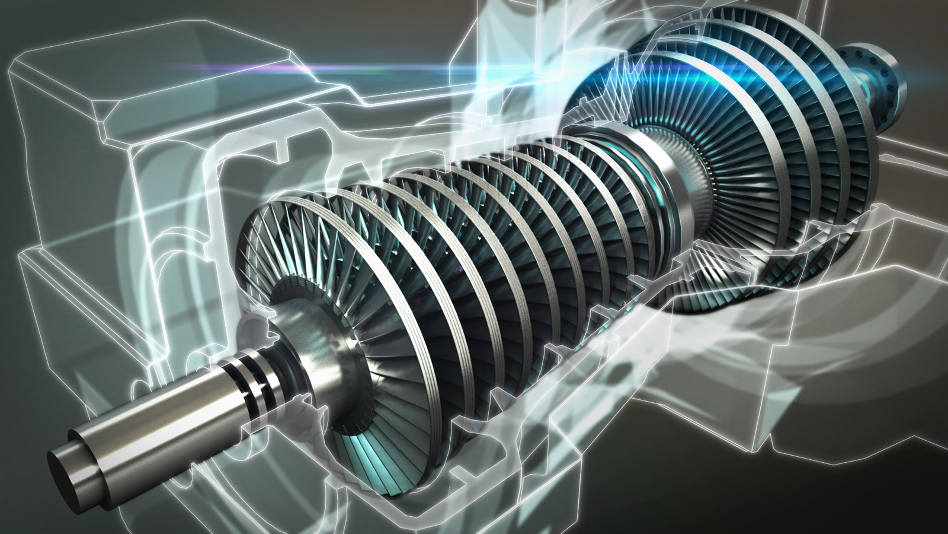
In energy production, steam from the reactor turns a turbine
which spins a shaft that connects to equipment
[i.ytimg.com]
Notes:
Example assertion-evidence slide from an engineering ambassador presentation. The sentence headline succinctly states the main message of the slide. The message should be one or two lines—our research has found that headlines more than two lines are not read. The visual evidence in this case is an artistic drawing. Such evidence could be photographs, drawings, diagrams, graphs, films, or equations. Bulleted lists are shunned, because bullets do not show connections.
Reference:
Atz, Emil, & Nomin Munkhbat (2016). Nuclear Power. Storrs, CT: University of Connecticut, Engineering Ambassadors.

Slide 8
Notes:
Blank slide for drafting a body slide.

Slide 9
This sentence headline makes an assertion on the second topic in no more than two lines
Call-out, if necessary: keep to one or two lines
Call-out, if necessary: keep to one or two lines
Image or equations supporting the headline assertion
Call-out, if necessary: keep to one or two lines
Notes:
Body slide from the second section of the presentation’s middle. For the first body slide of this second section, consider repeating the corresponding image (or equation) from the mapping slide. Use the headline to make an assertion about this topic. In the body of the slide, support that headline assertion with images and needed callouts. See Chapter 4 of The Craft of Scientific Presentations, 2nd ed.
This slide shows one orientation for the image and text in the body of the slide. Other orientations appear in this template. Choose the orientation that best supports your headline assertion.

Slide 10
Momentum is equal to the mass of an object multiplied by its velocity
p = mv
p = momentum
Notes:
Example assertion-evidence slide from an engineering ambassador presentation. The sentence headline succinctly states the main message of the slide. The message should be one or two lines—our research has found that headlines more than two lines are not read. The visual evidence in this case is an artistic drawing. Such evidence could be photographs, drawings, diagrams, graphs, films, or equations. Bulleted lists are shunned, because bullets do not show connections.
Reference:
Stevens, Dana, and Luke Kuprenas (2016). Nuclear Powered Spaceflight. Troy NY: Rensselaer Polytechnic Institute, Engineering Ambassadors.

Slide 11
Momentum is equal to the mass of an object multiplied by its velocity
p = mv
m = mass
Notes:
Example assertion-evidence slide from an engineering ambassador presentation. The sentence headline succinctly states the main message of the slide. The message should be one or two lines—our research has found that headlines more than two lines are not read. The visual evidence in this case is an artistic drawing. Such evidence could be photographs, drawings, diagrams, graphs, films, or equations. Bulleted lists are shunned, because bullets do not show connections.
Reference:
Stevens, Dana, and Luke Kuprenas (2016). Nuclear Powered Spaceflight. Troy NY: Rensselaer Polytechnic Institute, Engineering Ambassadors.

Slide 12
Momentum is equal to the mass of an object multiplied by its velocity
p = mv
v = velocity
Notes:
Example assertion-evidence slide from an engineering ambassador presentation. The sentence headline succinctly states the main message of the slide. The message should be one or two lines—our research has found that headlines more than two lines are not read. The visual evidence in this case is an artistic drawing. Such evidence could be photographs, drawings, diagrams, graphs, films, or equations. Bulleted lists are shunned, because bullets do not show connections.
Reference:
Stevens, Dana, and Luke Kuprenas (2016). Nuclear Powered Spaceflight. Troy NY: Rensselaer Polytechnic Institute, Engineering Ambassadors.

Slide 13
Notes:
Blank slide for drafting a body slide.

Slide 14
This sentence headline makes an assertion on the third topic in no more than two lines
Image supporting above assertion
Feature or call-out—no more than two lines
Feature or call-out—no more than two lines
Notes:
Body slide from the third section of the presentation’s middle. For the first body slide of this third section, consider repeating the corresponding image from the mapping slide. Use the headline to say state an assertion about this topic. In the body of the slide, support that headline with images and with needed callouts. See Chapter 4 of The Craft of Scientific Presentations, 2nd ed..
This slide shows one orientation for the image and text in the body of the slide. Other orientations appear in this template. Choose the orientation that best supports your headline assertion.

Slide 15
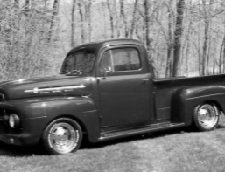
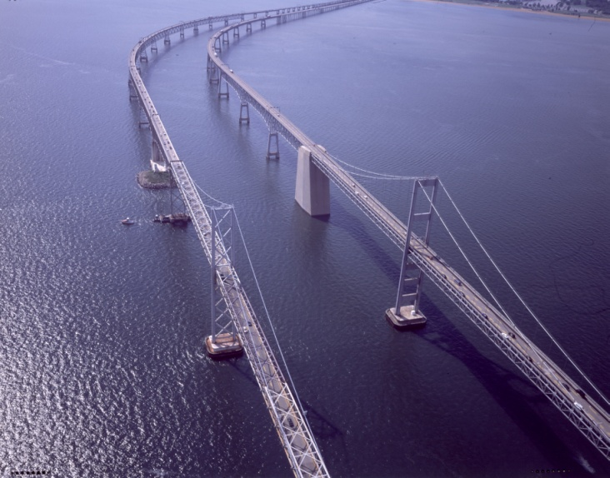
Since its construction in 1952, traffic across the bridge has grown exponentially
1952
1.1 million vehicles
[Maryland Transportation Authority, 2007]
[Maryland Transportation Authority, 2007]
Notes:
Sample slide from third section of the presentation’s middle: initial layer for this slide. This slide has three layers.
Reference:
Brittany Pavelko, “Proposal to Address Congestion Problems on Chesapeake Bay Bridge,” presentation (University Park, PA: Penn State, Effective Speaking for Engineers, 5 March 2009), layer 1.
15

Slide 16
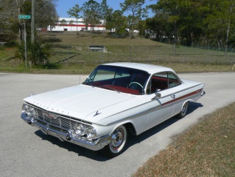
Since its construction in 1952, traffic across the bridge has grown exponentially
1952
1.1 million
1961
1.5 million
[Maryland Transportation Authority, 2007]
[Maryland Transportation Authority, 2007]
Notes:
Sample slide from third section of the presentation’s middle: second layer for this slide. This slide has three layers.
Reference:
Brittany Pavelko, “Proposal to Address Congestion Problems on Chesapeake Bay Bridge,” presentation (University Park, PA: Penn State, Effective Speaking for Engineers, 5 March 2009), layer 2.
16

Slide 17
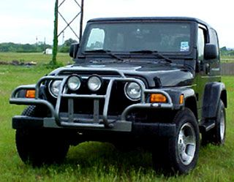
Since its construction in 1952, traffic across the bridge has grown exponentially
1952
1.1 million
1961
1.5 million
2007
27 Million
[Maryland Transportation Authority, 2007]
Notes:
Sample slide from third section of the presentation’s middle: initial layer for this slide. This slide has three layers.
Reference:
Brittany Pavelko, “Proposal to Address Congestion Problems on Chesapeake Bay Bridge,” presentation (University Park, PA: Penn State, Effective Speaking for Engineers, 5 March 2009), layer 3.
17

Slide 18
Notes:
Blank slide for drafting a body slide.

Slide 19
In summary, this sentence headline states the most important assertion of the presentation
Image that supports conclusion
Supporting point (no more than two lines)
Another supporting point (parallel to the first)
Questions?
Logo
Notes:
Conclusion slide. Use the headline (no more than two lines) to state your most important conclusion. Begin the headline with In summary or In conclusion to ensure that the audience knows they have come to the presentation’s end. Support that headline with an image and parallel points.
This slide should be your last slide. Audiences lose patience when they believe that they have come to the end, but other slides follow.
Notice that the word Questions appears at the bottom of this slide. That strategy is much more effective than burning a slide with just the word Questions. This slide allows the audience to look at the most important slide of the presentation during the question period. See The Craft of Scientific Presentations, 2nd ed., pages 182-183.

Slide 20
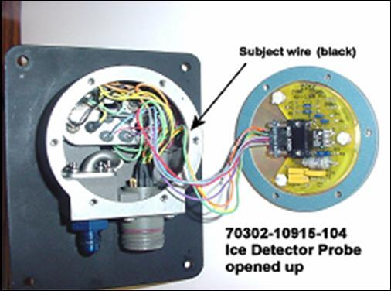
In summary, the detector failed because of a short-circuit created by the abrasion of wire insulation
Wires not harnessed to prevent contact with housing
Short circuit to ground created where wire contacted housing
Questions?
Notes:
Sample conclusion slide. Notice how the presenter showed the connection between words blocks on this slide—a strategy that is much more effective than a bullet list, which hides the connections between details.
Reference:
Manning Seltzer, “Failure Analysis of the Ice Detector in the Austria 13 Helicopter,” presentation (Hartford, CT: Sikorsky Helicopter, 30 April 2004).

Slide 21
Notes:
Blank slide for drafting a body slide.

